Slide 1


Slide 2
Vaibhav Patel
Wendy Xie
Rajkumar Senthilkumar
Neel Bhasvar
EDU-K8
TRAILSAFE

Slide 3
EDU-K8
TRAILSAFE
What does it do?|

Slide 4
EDU-K8
We improved the quality of education, offered by schools in third-world countries by providing them access to teaching materials off-line.
Edu-K8 is an USB disk containing an offline digital library for off-line use, which is update whenever internet connection is possible
TRAILSAFE

Slide 5
EDU-K8
TRAILSAFE
Inspiration?|

Slide 6
EDU-K8
Low access to consistent Wi-Fi connection
Low quality education
“ CUE estimates that 61 million African children will reach adolescence lacking even the most
basic literacy and numeracy skills “
Lack of proper teaching resources
“ There is an average of 40 pupils per teacher in sub-Saharan Africa, but the situation varies
considerably from country to country. In many countries, it is more than 60 to one. ”
TRAILSAFE

Slide 7
EDU-K8
TRAILSAFE
How we build it?|

Slide 8
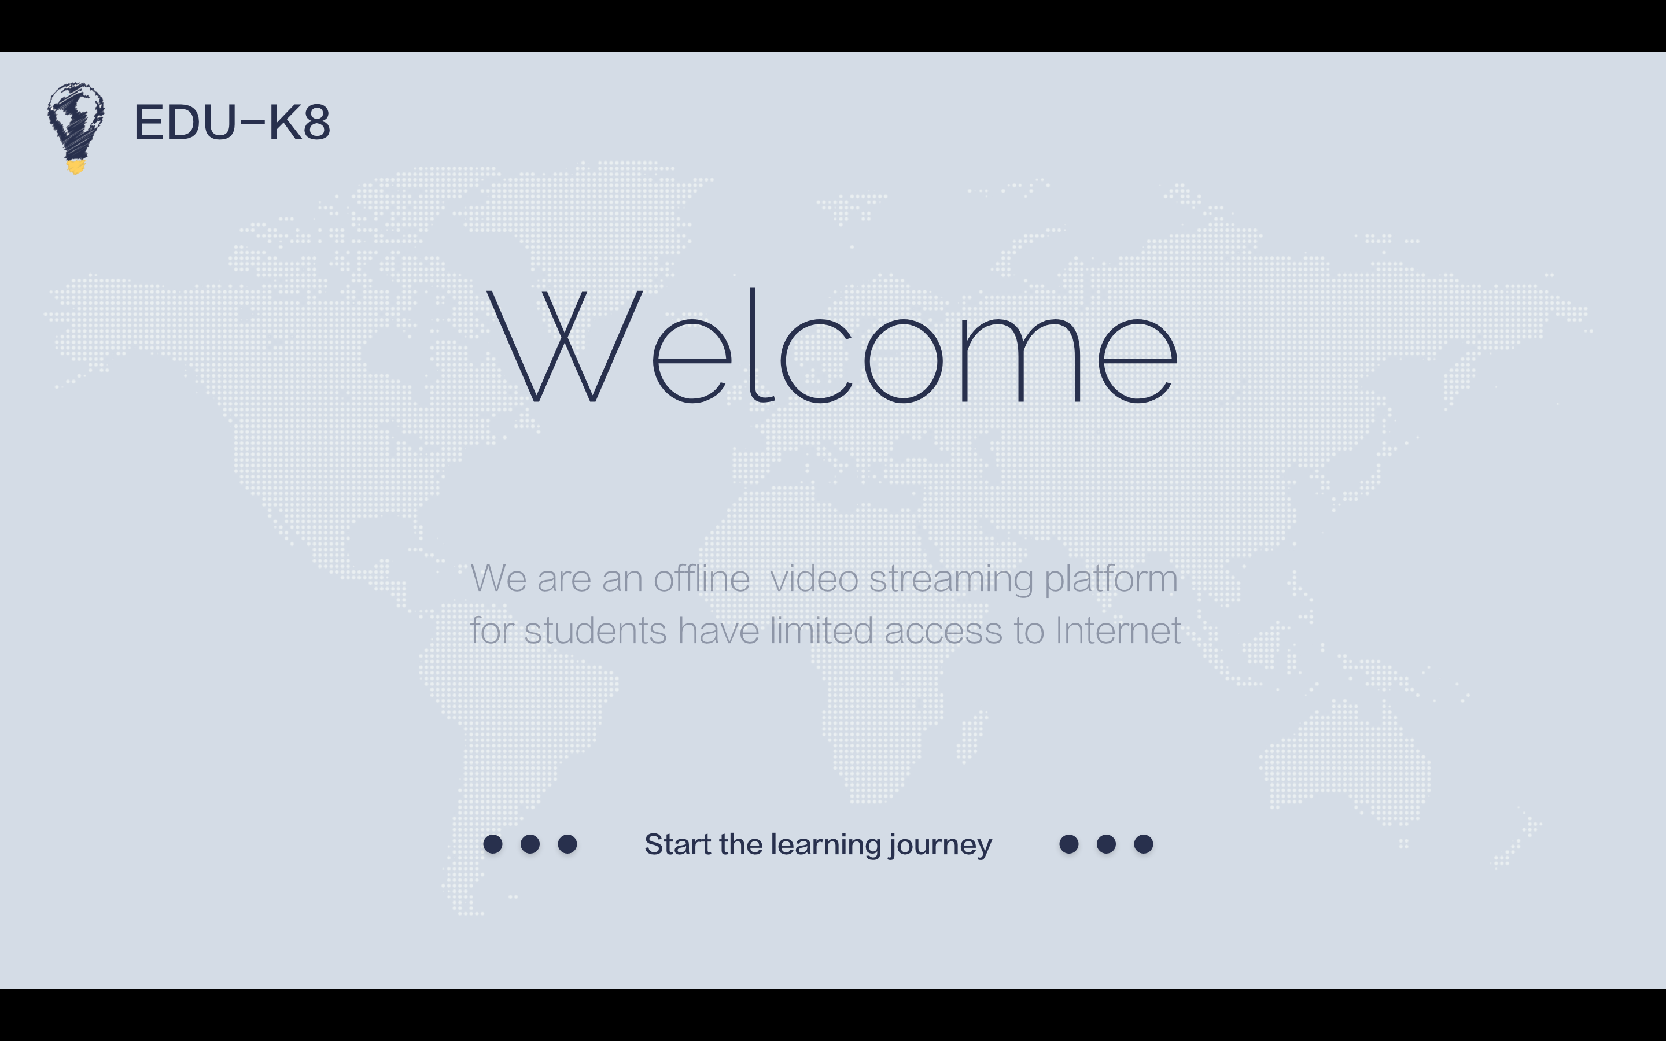

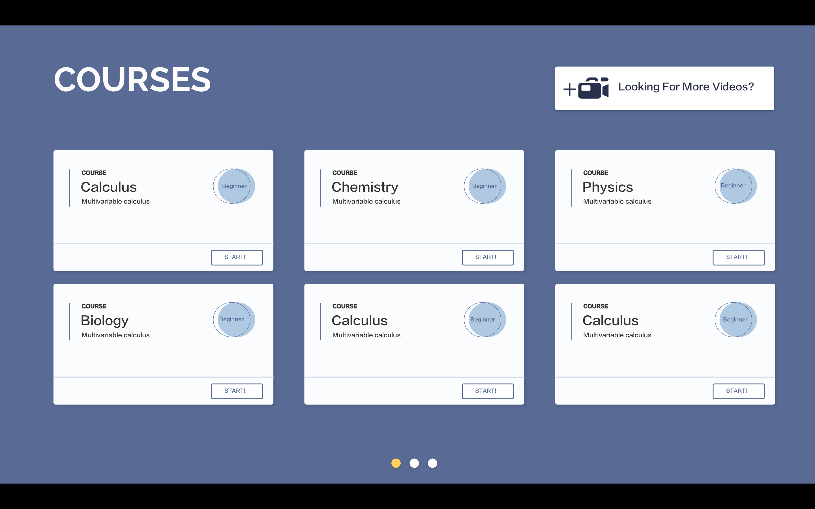
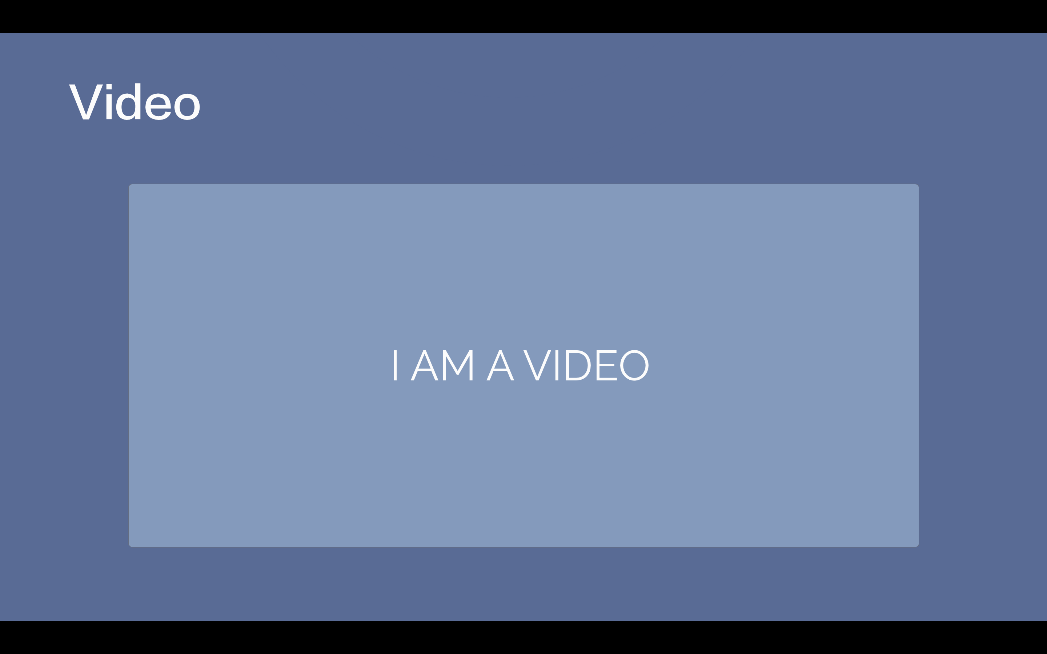
EDU-K8
TRAILSAFE

Slide 9
EDU-K8
TRAILSAFE
Thank you for listening!

